Slide 1
CWNA Guide to Wireless LANs,
Third Edition
Chapter 8: Conducting a Site Survey

Slide 2
Objectives
Explain what a site survey is and how it can be used
List and describe the tools used for conducting a site survey
Describe the procedures for performing a site survey

Slide 3
What is a Site Survey?
When installing a WLAN for an organization, areas of dead space might not be tolerated
  Ensure blanket coverage, meet per-user bandwidth requirements, minimize “bleeding” of signal
Factors affecting wireless coverage goals:
  Devices emitting RF signals
  Building structure (walls, construction materials)
  Open or closed office doors
  Stationary versus mobile machinery/equipment
  Movement of mobile walls (e.g., cubicles)

Slide 4
What is a Site Survey?
Factors affecting wireless coverage goals (continued):
  Expansion of physical plant or growth of organization
  Existing WLANs
    Both inside organization, and within nearby organizations
Site survey: Process of planning a WLAN to meet design goals
  Effectiveness of a WLAN often linked to thoroughness of the site survey

Slide 5
Purpose of a Site Survey
Design goals for a site survey:
  Achieve best possible performance from WLAN
  Certify that installation will operate as promised
  Determine best location for APs
  Develop networks optimized for variety of applications
  Ensure coverage will fulfill organization’s requirements
  Locate unauthorized APs

Slide 6
Purpose of a Site Survey
Design goals for a site survey (continued):
  Map nearby wireless networks to determine existing radio interference
  Reduce radio interference as much as possible
  Make wireless network secure
Survey provides realistic understanding of infrastructure required for proposed wireless link
  Assists in predicting network capability and throughput
  Helps determine exact location of APs and power levels required

Slide 7
When to Perform a Site Survey
When to perform a site survey:
  Before installing a new wireless network
  After physical changes to a building
  After changes to an existing wireless network
  If network needs change for the organization
  After significant changes in personnel
Automated RF resource management: a dynamic self-managing WLAN
  the wireless devices monitor the environment and automatically adjust power levels or channels to compensate for changes

Slide 8
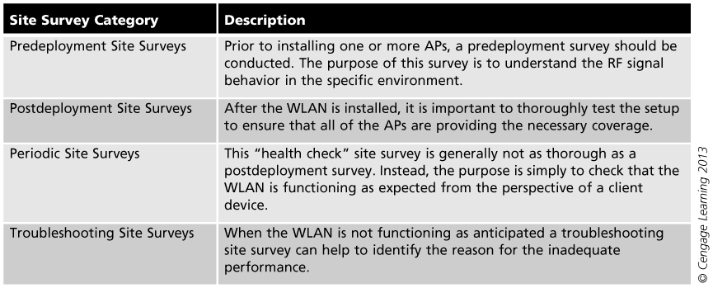
Table 8-1 Categories of Site Surveys

Slide 9
Types of Site Surveys
Manual site survey: requires walking through the area of the WLAN while carrying a wireless client like a laptop or tablet computer
Can be divided into two categories:
  Passive manual site survey: client device “listens” in order to gather RF measurements such as signal strengths, noise levels, and the signal-to-noise ratio (SNR)
  Active manual site survey: client device sends and receives packets to determine the status of the WLAN

Slide 10
Types of Site Surveys
Predictive site survey: a virtual survey of the area that uses modeling techniques to design the wireless network
  Building floor plans are loaded into the predictive analysis simulation application survey software (also called RF planning and management tools)
  Can account for building materials, square footage, number of wireless users, types of applications, antenna models, etc.

Slide 11
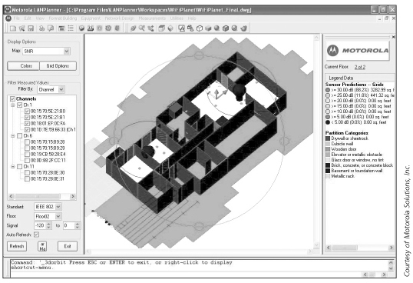
Figure 8-1 Predictive analysis simulation application

Slide 12
Types of Site Surveys
Type of data needed for an outdoor site survey:
  Height and material of buildings, light poles, or other structures that are to host an AP
  Location, size, and density of areas where trees, foliage, hills, or other obstacles may interfere with the signal
  Types of applications or the desired bandwidth to be carried
  Availability of power at each building, light pole, or outbuilding to power the APs
  Availability of data connectivity at each location

Slide 13
Site Survey Tools
Most predictive site survey software uses AutoCAD drawing files with embedded detail about building materials
For manual site surveys, a wide variety of tools are available:
  Single hardware “bundle” that includes software installed on a dedicated hardware device
  Software to be installed on different devices
  Wireless device tools

Slide 14
Wireless Device Tools
Most basic tool is AP itself:
  Position AP in various locations, monitor signal as you move
  APs should have ability to adjust output power
  APs should have external antenna connectors
    Test effectiveness of different antenna types in different situations
  May need DC-to-AC converter for testing
Notebook computer with wireless NIC also essential for testing
  Previously configured and tested

Slide 15
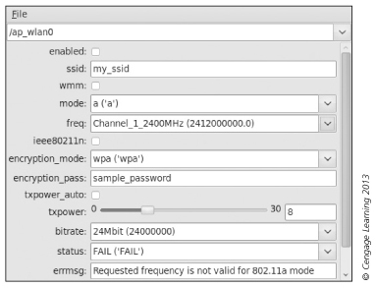
Figure 8-2 Adjust power levels with slider bar

Slide 16
Specialized Tools
Dedicated Applications: Specifically designed for conducting WLAN site surveys
  Full-featured site survey analyzer software settings:
    Destination MAC Address – AP that will be involved in the test
    Continuous Link Test – Active Mode test will run repeatedly until the Stop button is clicked
    Number of Packets – sets quantity of packets
    Packet Size – sets the size of the packets during test
    Data Retries – sets the number of times a transmission will be repeated if an ACK frame is not returned by the destination device

Slide 17
Specialized Tools
  Full-featured site survey analyzer software settings (continued):
    Data Rate – sets the bit rate packets will be transmitted
    Delay Between Packets
    Packet Tx Type - Unicast or multicast
    Percent Success Threshold
  Basic survey analyzer software contains far fewer features

Slide 18
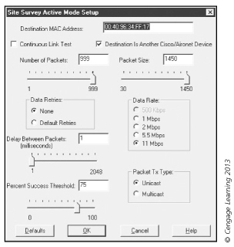
Figure 8-4 Full-featured dedicated application setup

Slide 19
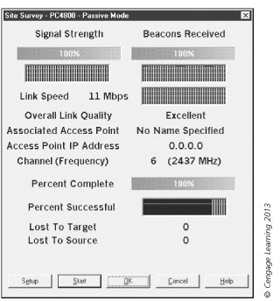
Figure 8-5 Full-featured dedicated application results

Slide 20
Specialized Tools
Spectrum Analyzers: Scans RF spectrum and provides graphical display of results
  Typically measure signal-to-noise ratio
  Most common spectrum analyzer measurements are modulation, distortion, and noise
  Helpful in identifying interference problems
    Thus, helps properly position/orient AP

Slide 21
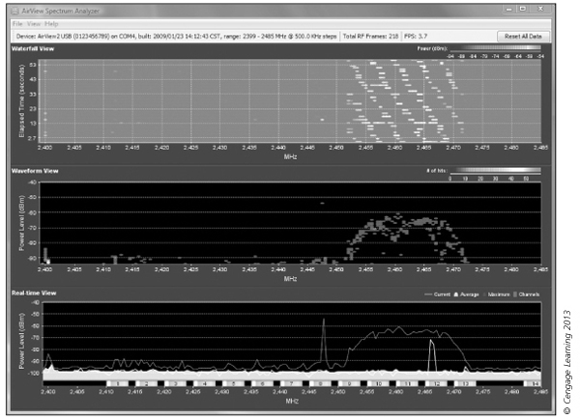
Figure 8-8 USB spectrum analyzer output

Slide 22
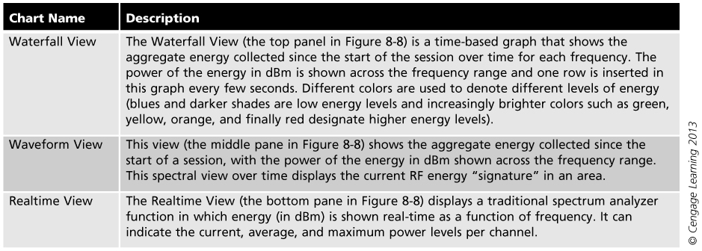
Table 8-2 Description of USB Spectrum Analyzer Views

Slide 23
Specialized Tools
Protocol Analyzers: Can be used to pick up packets being transmitted by other WLANs in area
  Also called a sniffer
  Can be a stand-alone protocol analyzer device or a computer that runs protocol analyzer software
Common uses of protocol analyzers:
  Network troubleshooting: can detect and diagnose problems such as addressing errors
  Network traffic characteristics: helps to fine-tune the network and manage bandwidth in order to provide the highest level of service to users

Slide 24
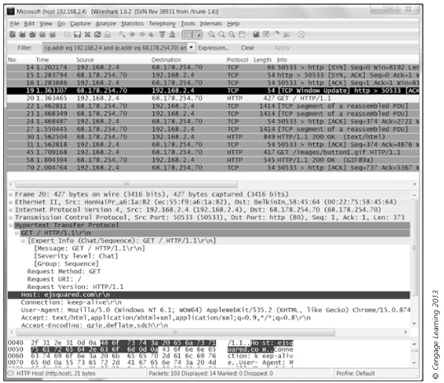
Figure 8-9 Protocol analyzer output

Slide 25
Specialized Tools
Documentation Tools
  Create a “hard copy” of site survey results
  Make available for future reference
Site survey report should include:
  Purpose of report
  Survey methods
  RF coverage details (frequency and channel plan)
  Throughput findings
  Sources of interference

Slide 26
Specialized Tools
Site survey report should include (continued):
  Problem zones
  Marked-up facility drawings with access point placement
  Access point configuration
It is advisable to create a database to store site survey information and generate reports

Slide 27
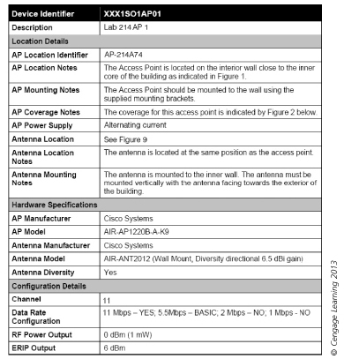
Figure 8-10 Sample site survey documentation form

Slide 28
Voice over WiFi (VoWiFi) Tools and Surveys
Voice over WiFi (VoWiFi): an implementation of VoIP telephony on a WLAN
Considerations when planning for VoWiFi:
  Packet loss: a high number of lost packets can cause a noticeable impact on voice communications
    Should be less than 1% in a VoWiFi network
  Delay: amount of acceptable time that a late packet can arrive and still be used
  Jitter: measure of delay between packets
    Less than 5 milliseconds is acceptable

Slide 29
Voice over WiFi (VoWiFi) Tools and Surveys
When performing a site survey the primary tools used are the built-in tools in the VoWiFi handset
When planning for VoWiFi:
  Have overlap between adjacent cells of coverage area to ensure sufficient RF signal strength
  Many VoWiFi handsets do not support 802.11n and do not have multiple antennas
    Some VoWiFi handsets support load balancing of moving a new call to an alternate channel that is less congested

Slide 30
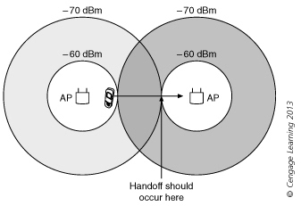
Figure 8-11 Cell overlap for VoWiFi

Slide 31
Procedures for Performing a Site Survey
Three basic steps in conducting a site survey:
  Gathering background data
  Performing the actual survey
  Generating the site survey report

Slide 32
Gathering Data
Examining Business Requirements: Determine business reasons why WLAN being proposed or extended
  If this step skipped, almost impossible to properly design and implement the network
  Primary data gathering method is interviewing
  Must determine type of mobility required within organization
  Must determine per-user bandwidth requirements
    May be different “types” of users with different bandwidth requirements

Slide 33
Gathering Data
Defining Security Requirements: Consider type of data encryption and type of authentication that will take place across WLAN
  Consider existing security policies and procedures
  Examine the physical requirements as well
Gathering Site-Specific Documentation:
  Blueprints, facility drawings, and other documents
    Show specific building infrastructure components
  Inspecting the site
    Document changes to blueprints and get visual perspective

Slide 34
Gathering Data
Gathering Site-Specific Documentation (continued):
  Behind-the-scenes site inspection
    May require ladder, flashlight, and an escort
Documenting Existing Network Characteristics: New or expanded WLAN will “dovetail” into network already in place
  How does current network support the mission?
  What applications run on the network?
  How many users does it support?
  What are the strengths and weaknesses of current network?

Slide 35
Gathering Data
Documenting Existing Network Characteristics (continued):
  What is the anticipated growth?
  Types of information should be included in the current network documentation include:
    Number and types of clients
    Number of servers
    Topology of the network
    Type of media being used
    Performance of the network
    Types of devices connected to the network

Slide 36
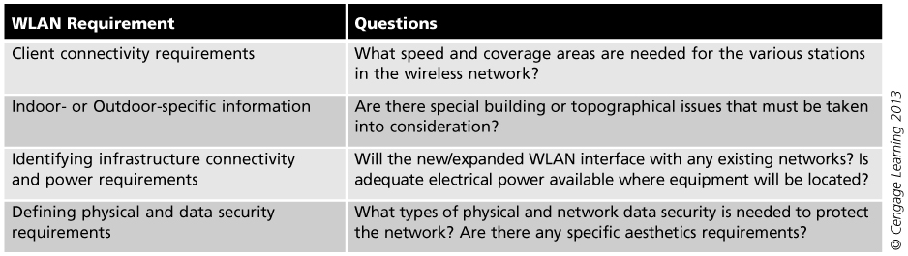
Analyzing Technical Requirements
Gathering data to determine the technical requirements for the WLAN is important
Table 8-4 WLAN requirements

Slide 37
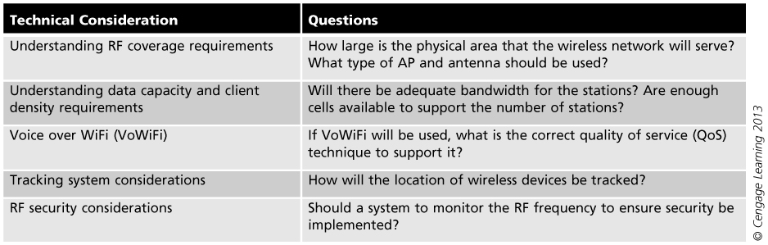
Table 8-5 Wireless technical considerations

Slide 38
Performing the Survey
Access Point Configuration and Location:
  Decide the type of AP that will be used
  Configure the AP for optimum power output and channel assignments
  Position AP
    Initial location will depend on antenna type
    Document starting position of AP
  Using notebook computer with site survey analyzer software running, walk slowly away from AP
    Observe data displayed by analyzer program
      Data rate, signal strength, noise floor, and signal-to-noise ratio

Slide 39
Performing the Survey
Identifying Interference:
  May come from many different objects (see Table 8-6 on next slide)
  May come from another nearby WLAN
    Both networks may attempt to use the same or adjacent channel
Outdoor Surveys: Similar to indoor surveys, but must consider climatic conditions, trees, different possibilities for antenna positions

Slide 40
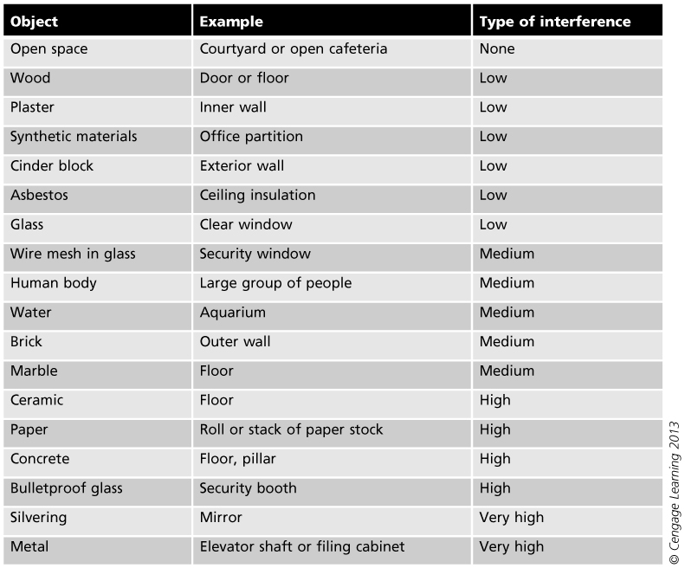
Table 8-6 Interference by objects

Slide 41
Creating the Site Survey Report
Narrative section:
  State customer requirements
  Outline methodology
    Outline all steps taken during survey
  Clearly state results of measurements
    May have tables of measurements
  Recommendations
    Should always address security

Slide 42
Creating the Site Survey Report
Graphic section:
  Generally includes maps and diagrams of coverage area
    Data rate coverage map
    Signal-to-noise ratio plot

Slide 43
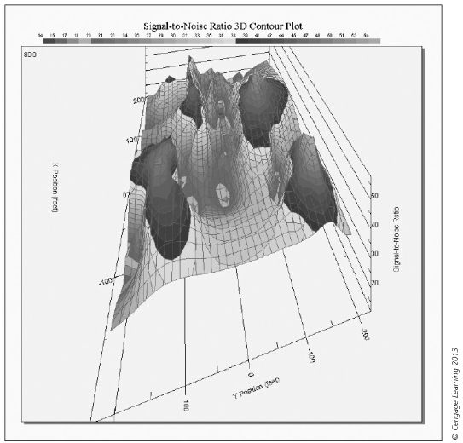
Figure 8-13 3-D SNR plot

Slide 44
Summary
A site survey is an in-depth examination and analysis of a proposed wireless LAN site to meet design goals
A manual site survey involves walking through the area of the WLAN while carrying a laptop or tablet
A predictive site survey is a virtual survey of the area that uses modeling techniques to design the WLAN using predictive analysis simulation application survey software

Slide 45
Summary
Categories of tools used
  Wireless tools include the access point and notebook computers with a wireless NIC
  Measurement tools include site survey analyzers, spectrum analyzers, and network analyzers
Three steps in conducting a site survey
  Gather the background data
  Perform the actual survey
  Create the site survey report, containing a narrative and a graphical section

Slide 46
Summary
Outdoor surveys are similar to indoor surveys, but must consider climatic conditions, trees, different possibilities for antenna positions

